Slide 1
InterviewSense AI Shehla Shireen

Slide 2
INTRODUCTION
InterviewSense AI combines computer vision and machine learning to evaluate interview performance through:
Real-time emotion detection (Angry, Happy, Sad, Surprise, Neutral, Disgust, Fear)
Eye contact tracking with percentage-based scoring
Stress level analysis based on negative emotion dominance
Comprehensive reporting with actionable feedback

Slide 3
PROBLEM IT SOLVES
This tool is designed for HR professionals, interview coaches, and candidates looking to improve their interview performance through data-driven feedback.

Slide 4
Architecture
The system consists of two main components:
Frontend (Streamlit Application)
Real-time webcam feed processing
Live dashboard with metrics visualization
Video upload and analysis capability
Admin configuration panel
Automated report generation in Word format
Backend (FastAPI Server)
TensorFlow emotion detection model
MediaPipe for facial landmark detection
Eye contact estimation algorithms
Head movement tracking
REST API endpoint for image processing

Slide 5
Key Features
Multi-Page Interface:
Interview Dashboard: Real-time webcam analysis
Video Upload: Process recorded interviews
Admin Dashboard: Configure evaluation parameters
Smart Analysis:
15-frame rolling average for smooth metrics
Emotion dominance tracking (not just averages)
Configurable expected ranges for different emotions
Binary stress classification (High/Low) based on negative emotion prevalence

Slide 6
Professional Reporting :
Automated Microsoft Word report generation
Color-coded performance indicators
Detailed metrics and compliance tables
Personalized recommendations for improvement

Slide 7
Technical Details
Emotion Model: Pre-trained TensorFlow model downloaded from Google Drive
Face Detection: Haar Cascade classifier
Eye Tracking: MediaPipe Face Mesh for precise iris detection
Stress Calculation: Based on percentage of frames where negative emotions are dominant
Data Persistence: JSON-based configuration saving

Slide 8
Output Metrics
Emotion Analysis: Confidence scores for all 7 emotions
Eye Contact: Percentage score (0-100%) with performance categorization
Stress Level: Binary classification (High/Low) based on negative emotion prevalence
Overall Interview Status: Composite score (Good/Average/Bad) based on multiple factors

Slide 9
Facial Emotion Detection using CNNs

Slide 10
Dataset
Total Images = 35,000 approximately
FER2013 – facial images dataset (only 5 emotions – happy, angry, sad, surprise,neutral)
Data Augmentation

Slide 11
Image Preprocessing
Input size: 48x48 grayscale images
Unsharp Mask Filter -> enhance edges
Image Normalization

Slide 12
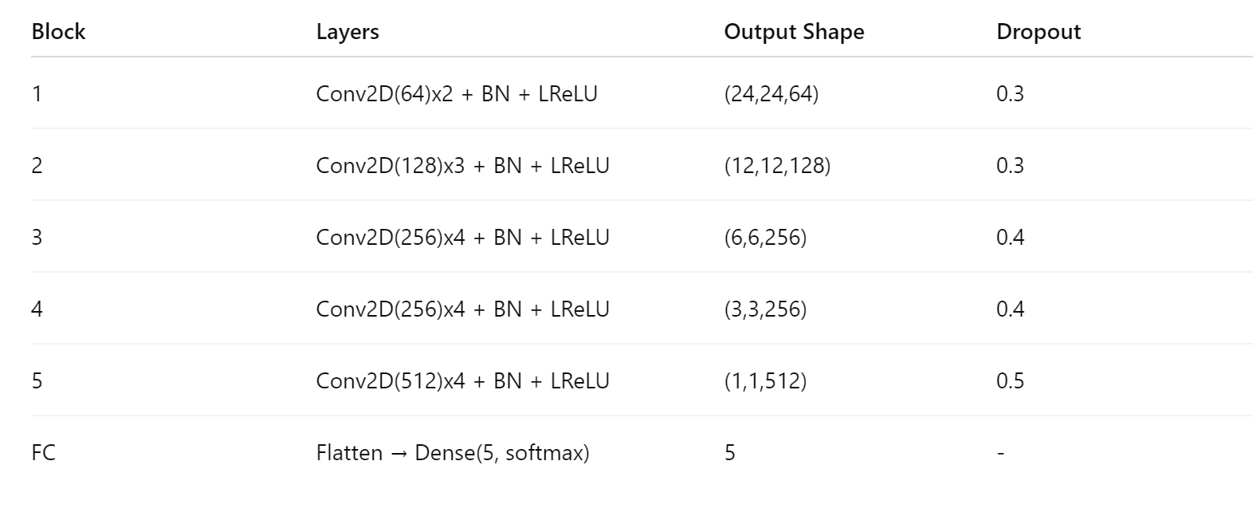
Architecture

Slide 13
Hyperparameters
Minibatch size=32
Epochs: 50
Optimizer: Adam
Initial learning rate: 1e-4 (0.0001)
Learning rate scheduler: ReduceLROnPlateau
Factor: 0.5 (reduces LR by half)
Patience: 3 epochs without val improvement before reducing LR
Minimum LR allowed: 1e-7
Loss function: Categorical Crossentropy
Metrics tracked:
Accuracy
Precision
Recall
AUC (Area Under ROC Curve)
Loss

Slide 14
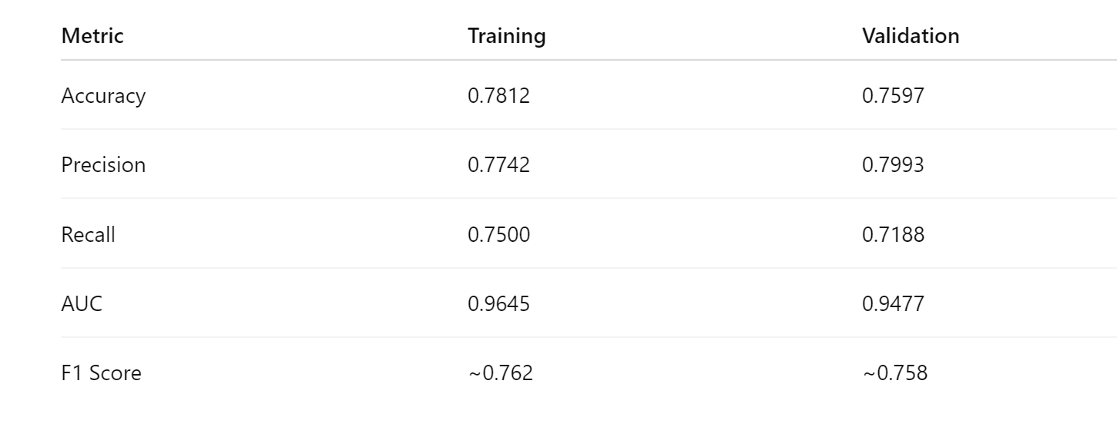
Results

Slide 15
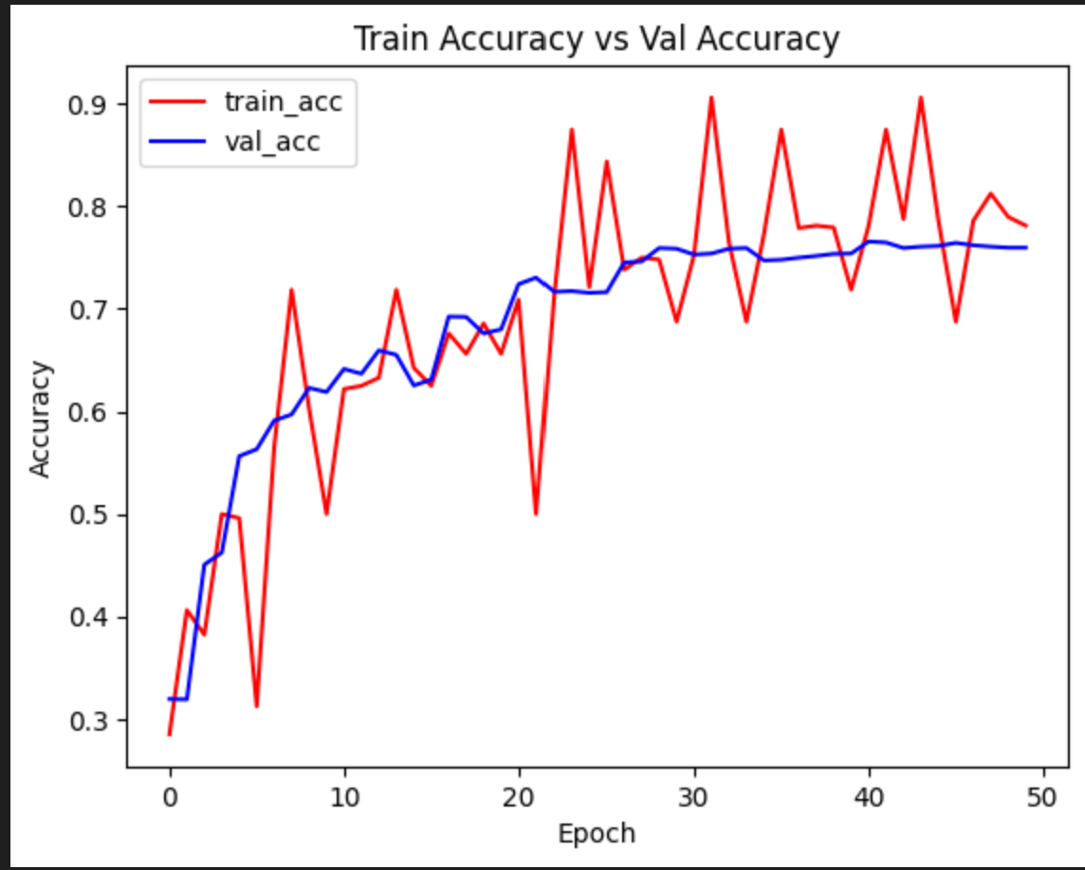
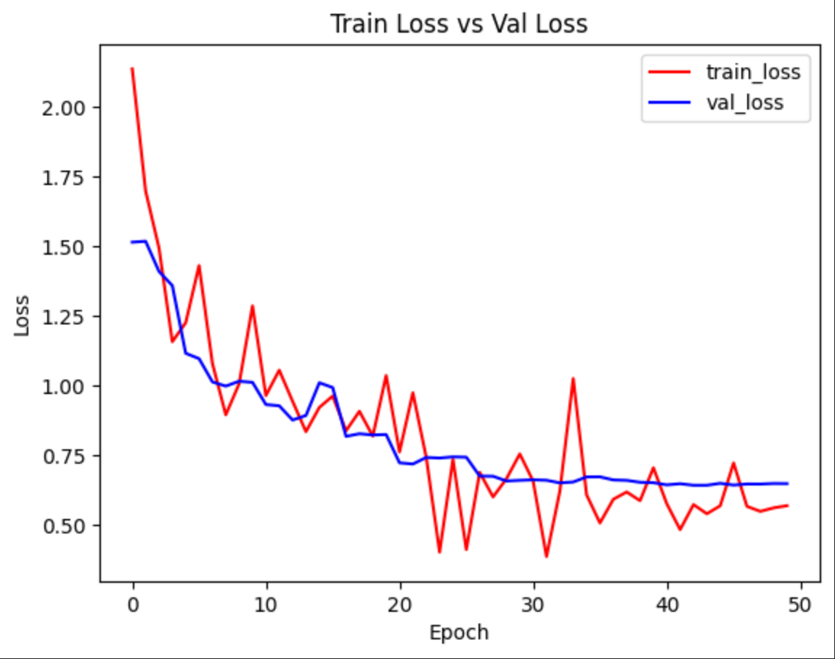
Graphs

Slide 16
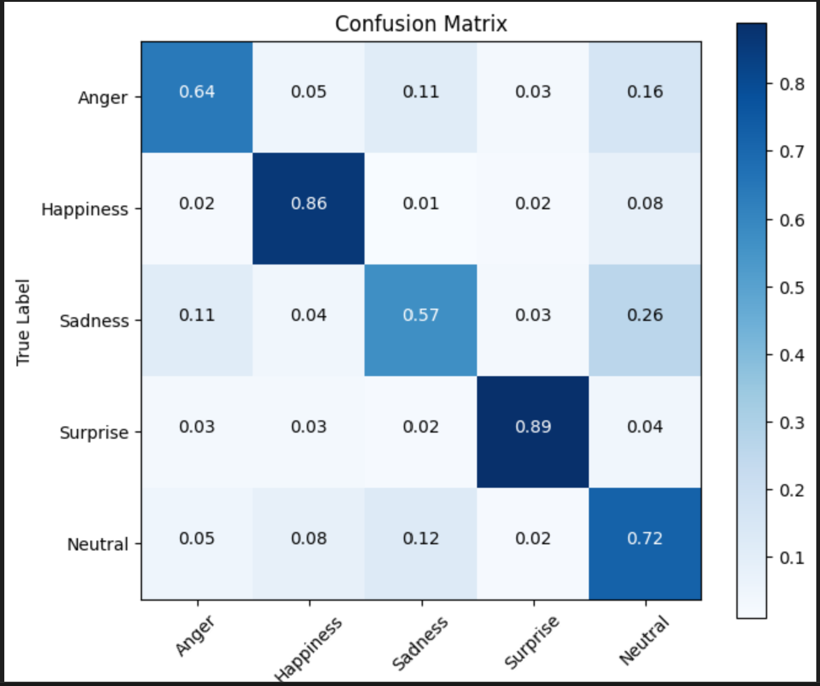
Confusion matrix

Slide 17
THANK YOU

